Slide 1
Final Project: Classification, Image Reconstruction and Model Analysis
Machine Learning
Quanshi Zhang
2022 Spring

Slide 2
Objective
The objective of this project is to help you have a deep insight on machine learning, including an intuitive understanding of the feature and the model.
Specifically, this project has two kinds of tasks, including the required task and three optional tasks. You should complete the required task, and select two optional tasks. All tasks should be implemented by yourself, instead of directly using any existing open source codes.
As long as your code does not have a bug (e.g., the classification accuracy of the neural network trained by yourself is significantly lower than that of a neural network of similar complexity), we do not evaluate the project based on the accuracy, because this final project is not a competition for the accuracy.

Slide 3
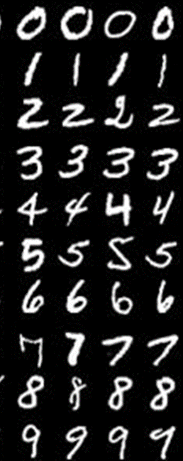
Required task: Handwritten digit classification
Dataset: MNIST database of handwritten digits http://yann.lecun.com/exdb/mnist/
The MNIST database of handwritten digits has a training set of 60,000 examples, and a test set of 10,000 examples. The MNIST consists of 10 classes. Each image has 28x28 pixels.
If you do not have enough computational resource, you can use a subset of training samples. You can use the first 1000 examples from each class for training, i.e. 10000 training samples from 10 classes in total. However, the test set should not be changed. In this scenario, you should clarify the size of the training set you used for training in the report.

Slide 4
Neural networks for the handwritten digit classification
You should design one or two neural network by yourself. Specifically, each designed neural network should contain 12-35 layers, including convolutional layers, ReLU layers, Batch Normalization layers, fully connected layers, and maxpooling layers.
You should not directly use classical neural networks (including but not limited to VGG-11/16/19, AlexNet, ResNet-18/24/32/36/44/56/102, DenseNet, GoogLeNet, and InceptionNet). Moreover, you should not design a new neural network by just adding or removing several layers from the above classical neural networks.

Slide 5
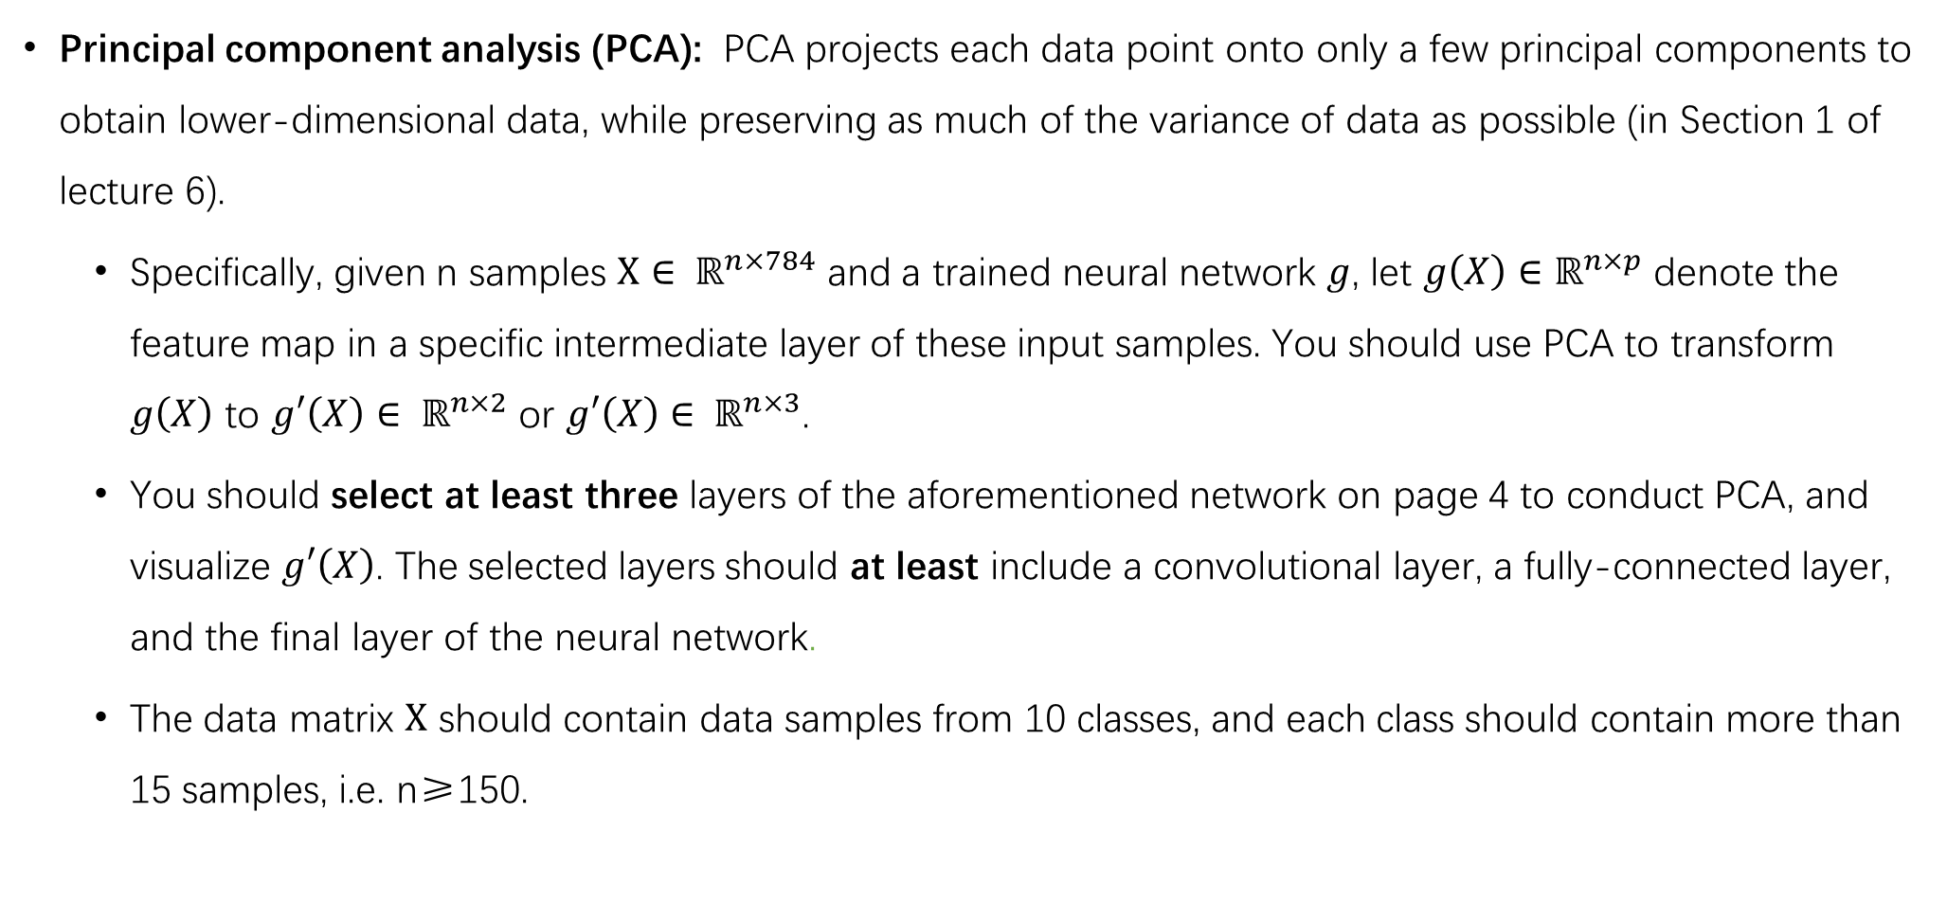
Feature Visualization on at least one designed neural network
Principal component analysis (PCA): PCA projects each data point onto only a few principal components to obtain lower-dimensional data, while preserving as much of the variance of data as possible (in Section 1 of lecture 6).
Specifically, given n samples $X∈ ℝ^{n×784}$ and a trained neural network $g$, let $g\left(X\right)∈ℝ^{n×p}$ denote the feature map in a specific intermediate layer of these input samples. You should use PCA to transform $g\left(X\right)$ to $g′\left(X\right)$ $∈ ℝ^{n×2}$ or $g′\left(X\right)$ $∈ ℝ^{n×3}$.
You should select at least three layers of the aforementioned network on page 4 to conduct PCA, and visualize $g′\left(X\right)$. The selected layers should at least include a convolutional layer, a fully-connected layer, and the final layer of the neural network.
The data matrix $X$ should contain data samples from 10 classes, and each class should contain more than 15 samples, i.e. n≥150.

Slide 6
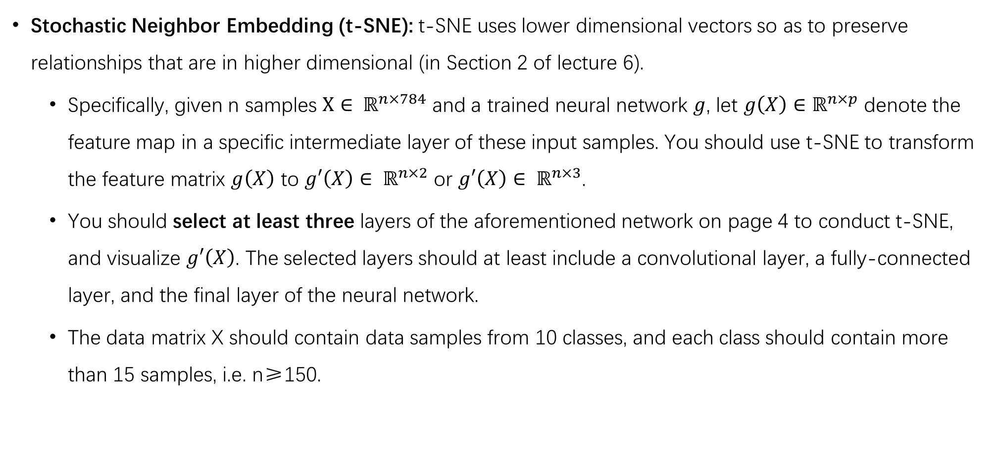
Feature Visualization on at least one designed neural network
Stochastic Neighbor Embedding (t-SNE): t-SNE uses lower dimensional vectors so as to preserve relationships that are in higher dimensional (in Section 2 of lecture 6).
Specifically, given n samples $X∈ ℝ^{n×784}$ and a trained neural network $g$, let $g\left(X\right)∈ℝ^{n×p}$ denote the feature map in a specific intermediate layer of these input samples. You should use t-SNE to transform the feature matrix $g\left(X\right)$ to $g′\left(X\right)$ $∈ ℝ^{n×2}$ or $g′\left(X\right)$ $∈ ℝ^{n×3}$.
You should select at least three layers of the aforementioned network on page 4 to conduct t-SNE, and visualize $g′\left(X\right)$. The selected layers should at least include a convolutional layer, a fully-connected layer, and the final layer of the neural network.
The data matrix X should contain data samples from 10 classes, and each class should contain more than 15 samples, i.e. n≥150.

Slide 7
What you need to write in the report for the required task
You should introduce architectures of neural networks designed by yourself and explain why you use such an architecture. It would be better to draw a diagram, which is shown as follows. Specifically, you should clarify the size of the feature map of each layer and hyper-parameters used to train the designed neural network.
You should report the classification accuracy on the test set. Besides, you should also report the classification accuracy and loss on the training set.
You should use both PCA and T-SNE to visualize features. You should observe these visualization results and try to summarize some empirical conclusions. The summary of some empirical conclusions is an open problem.
……
Conv 5x5
20x24x24
ReLU
……

Slide 8
Optinal task 1: Image reconstruction
Please design and implement a Variational auto-encoder (VAE) for image reconstruction by yourself, you are not allowed to directly use a neural network from any pre-existing open source code.
Please visualize reconstructed images.

Slide 9
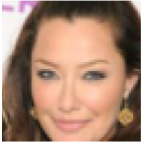
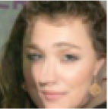
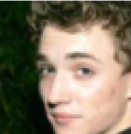
Optinal task 1: Image reconstruction
Please use Linear interpolation to generate images with specific properties.
For example, given two output features of the encoder, i.e., $z_{1}$ and $z_{2}$, the decoder takes $z_{1}$ as the input to generate a face image of a woman, and takes $z_{2}$ as the input to generate a face image of a man. You can use Linear interpolation to obtain a new feature $z=αz_{1}+(1−α)z_{2},α∈(0,1)$. Then, the decoder takes $z$ as the input to generate a new face image. You are required to do experiments with different values of $α$, e.g., $α=0.2, 0.4, 0.6, 0.8$, so as to obtain a set of face images.
You can conduct experiments on any two categories (e.g., old and young, shirt and bag)
Image generated from $z_{1}$
Image generated from $z$
Image generated from $z_{2}$

Slide 10
Datasets for optional task 1
Please choose one dataset to train a VAE
Fashion-MNIST
Large-scale CelebFaces Attributes (CelebA) Dataset.
If you choose CelebA dataset, you should use pre-processing images, i.e., face images with bounding boxes around faces.
If you do not have a strong GPU, you can choose one of the following small sizes of face images in CelebA dataset, including 128x128, 64x64, and 32x32, but 16x16 is not allowed.

Slide 11
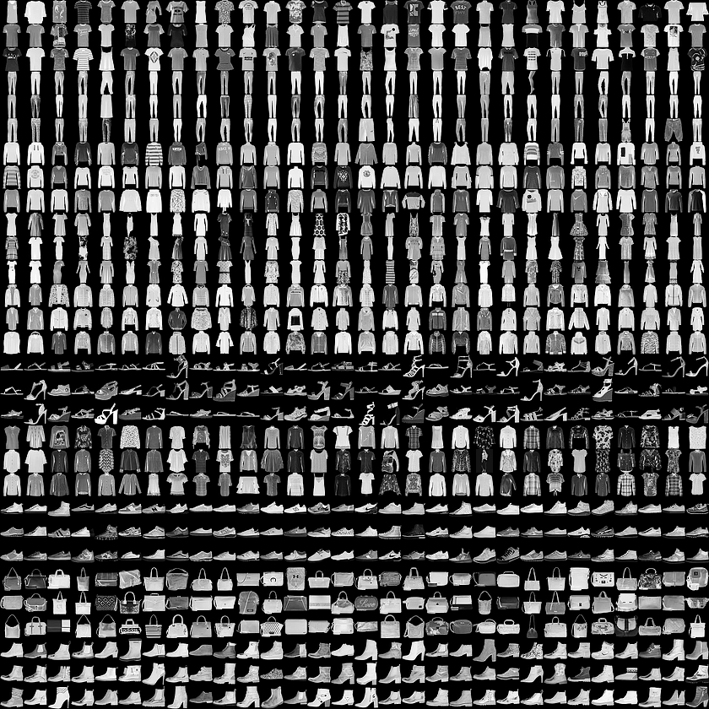
Fashion-MNIST
https://github.com/zalandoresearch/fashion-mnist
70000 images
10 classes
Each image has 28x28 pixels
60,000 training images
10,000 testing images

Slide 12
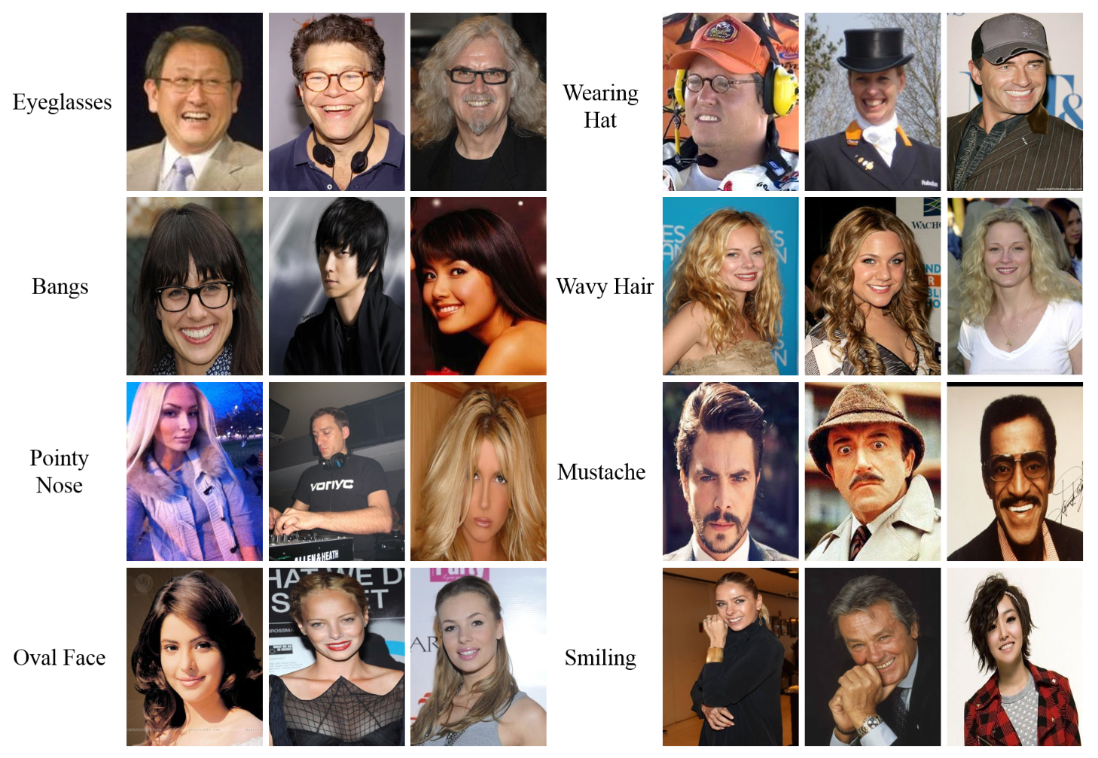
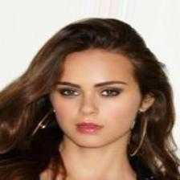
CelebA dataset
http://mmlab.ie.cuhk.edu.hk/projects/CelebA.html
More than 200k celebrity images
10,177 number of identities
202,599 number of face images
5 landmark locations, 40 binary attributes annotations per image.
You should use face images cropped with bounding boxes, instead of the entire image, such as the right face image.

Slide 13
What you need to write in the report for optional task 1
You should introduce the overall architecture of the VAE, which is designed by yourself. It would be better if you draw a diagram.
You should write how you implement the VAE that is designed by yourself.
You should visualize reconstructed images.
You should use interpolation to generate images with different properties.
Note that we will not strictly compare the quality of generated images under similar network complexity, as long as there are not strange results that indicate a bug.

Slide 14
Optional task 2: Visualization methods to explain DNNs
Use visualization methods to explain at least two DNN models
You can download pre-trained DNN architectures directly.
ResNet-18: https://download.pytorch.org/models/resnet18-5c106cde.pth
VGG-16: https://download.pytorch.org/models/vgg16-397923af.pth
Alexnet: https://download.pytorch.org/models/alexnet-owt-4df8aa71.pth
Other architectures
Choose visualization methods to explain models.
Optional task 2 requires you to read papers. These papers are easy to read.
Select at least two of Guided backpropagation / Grad-CAM / Shapley value / Layer-Wise Relevance Propagation / Integrated Gradients to explain the pre-trained models.
Compare the visualization results of the visualization methods you chose for the pre-trained models, and analyze your visualizations.
Write the code by yourself, instead of using any open source code directly.
The mathematical formula for the selected method needs to be reported.
Please explain the formula and its notations clearly.

Slide 15
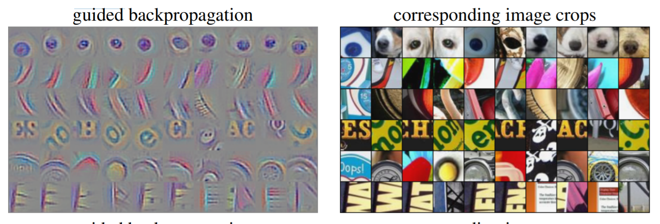
Guided backpropagation
Guided backpropagation: Visualize the patterns learned by different layers of the network, as shown in the left figure.
Jost Tobias Springenberg, Alexey Dosovitskiy, Thomas Brox, Martin Riedmiller, Striving for Simplicity: The All Convolutional Net, in arXiv:1412.6806

Slide 16
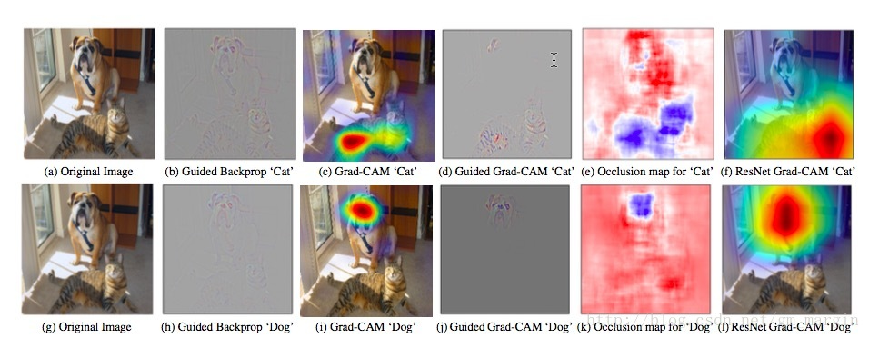
Grad-CAM
Grad-CAM: Visualize the importance of regions in the input image.
Ramprasaath R. Selvaraju, Michael Cogswell, Abhishek Das, Ramakrishna Vedantam, Devi Parikh, Dhruv Batra, Grad-CAM: Visual Explanations from Deep Networks via Gradient-based Localization, in arXiv:1610.02391

Slide 17
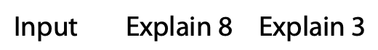
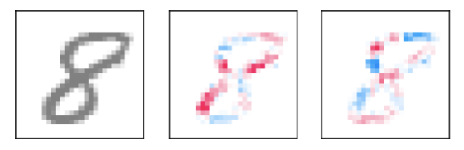
Shapley value
Shapley value : Visualize the importance of individual pixels or regions in the input image.
(Shapley value) Lloyd S Shapley. A value for n-person games. In: Contributions to the Theory of Games 2.28 (1953), pp. 307–317. 28. Princeton, NJ: Princeton University Press; 1957. p. 307--17.
(Shapley value to visually explain the model) Please read Section 3.1 of Hao Zhang, Jiayi Chen, Haotian Xue, Quanshi Zhang, Towards a unified evaluation of explanation methods without ground truth, in arXiv: 1911.09017.（This paper does not use the Shapley value to visually explain the model. Instead, this paper briefly introduces the Shapley value in Section 3.1. ）

Slide 18
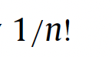
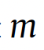
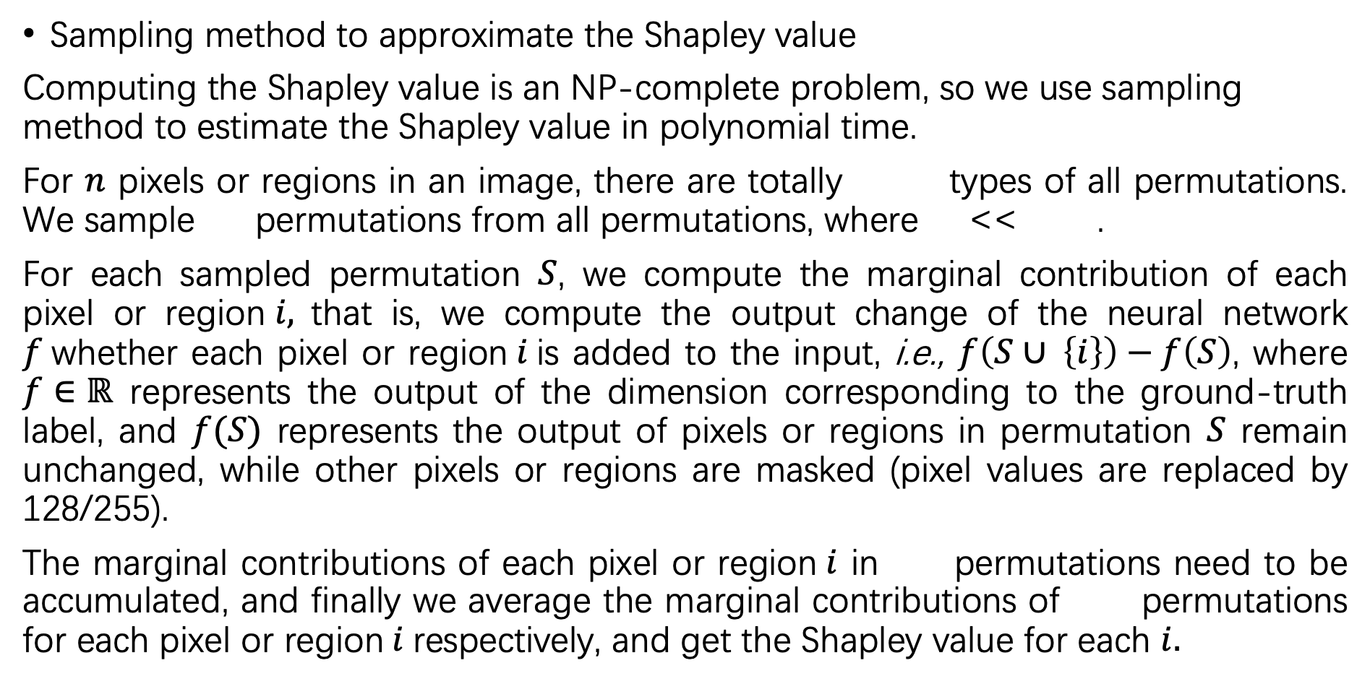
Shapley value
Sampling method to approximate the Shapley value
Computing the Shapley value is an NP-complete problem, so we use sampling method to estimate the Shapley value in polynomial time.
For $n$ pixels or regions in an image, there are totally types of all permutations. We sample permutations from all permutations, where << .
For each sampled permutation $S$, we compute the marginal contribution of each pixel or region$i,$that is, we compute the output change of the neural network $f$whether each pixel or region$i$is added to the input, i.e., $f\left(S∪ \left\{i\right\}\right)−f\left(S\right)$, where $f∈ℝ$ represents the output of the dimension corresponding to the ground-truth label, and $f(S)$ represents the output of pixels or regions in permutation $S$ remain unchanged, while other pixels or regions are masked (pixel values are replaced by 128/255).
The marginal contributions of each pixel or region$i$ in permutations need to be accumulated, and finally we average the marginal contributions of permutations for each pixel or region$i$respectively, and get the Shapley value for each $i.$

Slide 19
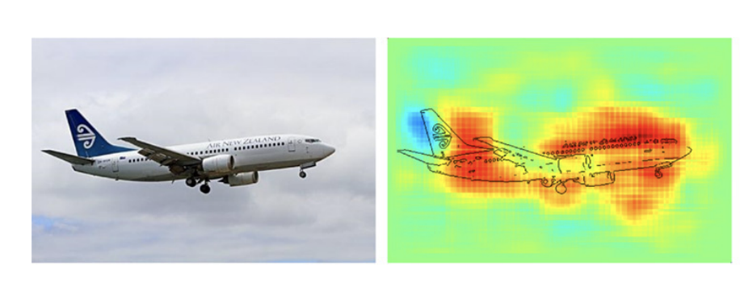
Layer-Wise Relevance Propagation
Layer-Wise Relevance Propagation: Visualize the importance of individual pixels in the input image.
Sebastian Bach, Alexander Binder, Grégoire Montavon, Frederick Klauschen, Klaus-Robert Müller, Wojciech Samek, On Pixel-Wise Explanations for Non-Linear Classifier Decisions by Layer-Wise Relevance Propagation, in PLOS one

Slide 20
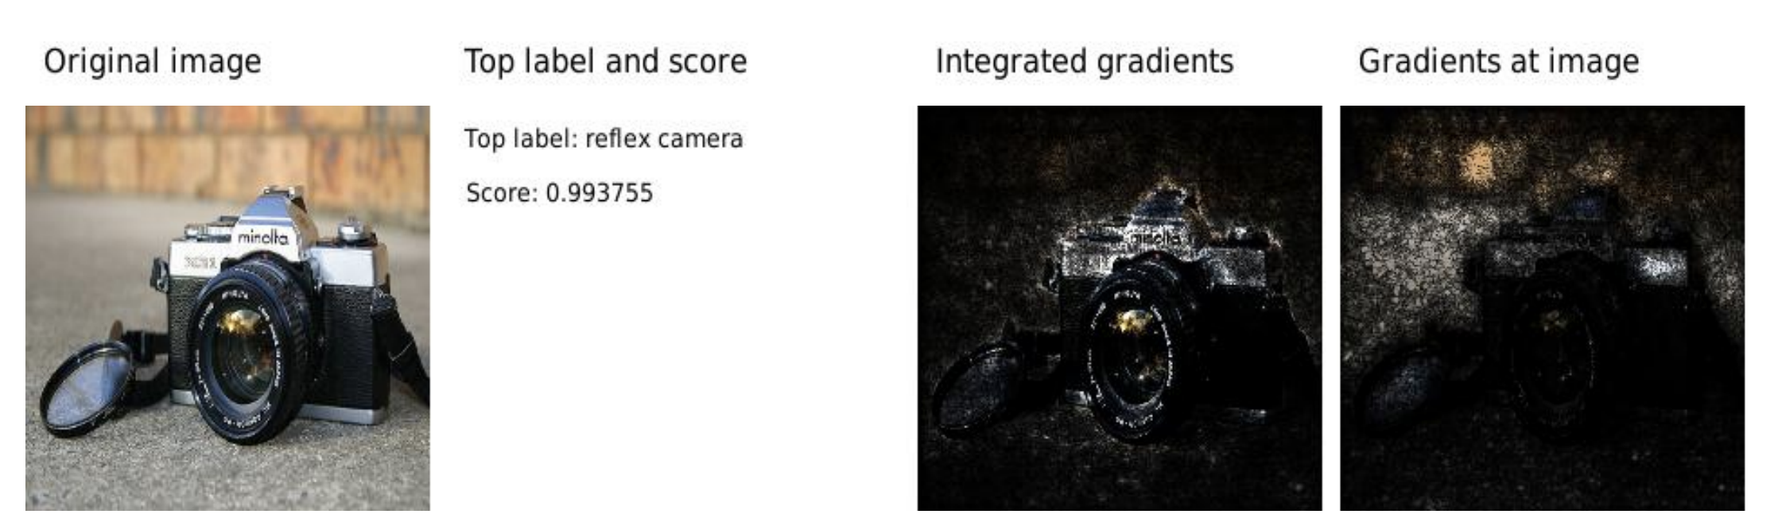
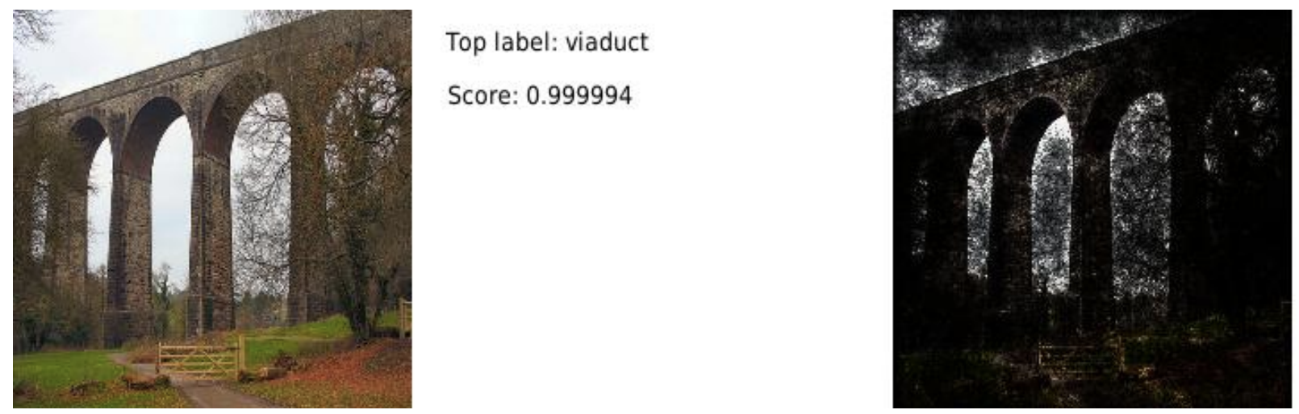
Integrated Gradients
Integrated Gradients: Visualize the importance of individual pixels in the input image.
Mukund Sundararajan, Ankur Taly, Qiqi Yan, Axiomatic Attribution for Deep Networks, in arXiv:1703.01365

Slide 21
Optional task 3: Binary sentiment classification on SST-2 dataset
Please design and implement an LSTM for binary sentiment classification task by yourself, instead of directly using an LSTM from any existing open source code.
Please use both PCA and T-SNE (see Page 5 and Page 6 for details) in the required task to visualize intermediate-layer features.
Considering you may not have GPUs, the goal of this optional task is not to PK the classification accuracy. However, you should ensure the classification accuracy of your LSTM is not significantly lower than that of a well-trained LSTM of the same complexity.

Slide 22
Dataset for Optional task 3
SST-2 dataset : https://nlp.stanford.edu/sentiment/
Containing 11,855 sentences.
For example：
The sentence “a stirring , funny and finally transporting re-imagining of beauty and the beast and 1930s horror films ”has a positive sentiment.
The sentence “a fan film that for the uninitiated plays better on video with the sound turned down .”has a negative sentiment.
Notes:
3. LSTM训练SST-2
单词层面可视化

Slide 23
What you need to write in the report for optional task 3
You should introduce the architecture of the LSTM. It would be better if you draw a diagram.
You should write code for LSTM instead of using off-the-shelf codes.
You should report the classification loss and the classification accuracy of both the training set and the validation set.
You should should use both PCA and T-SNE to visualize features, and analyze these experimental results.

Slide 24
Submit a report
Code & report
Do not copy others’ codes or others’ reports
The teaching assistant will check the code and the report.
Make sure your code can run
Deadline
Wednesday in the 17th week (June 8)
Please ask questions if you have.
Take it easy. The purpose of this project is not to distinguish bad and good students. Have fun!

